Slide 1
1.7: Competitive Analysis
By: Minal Bombatkar

Slide 2

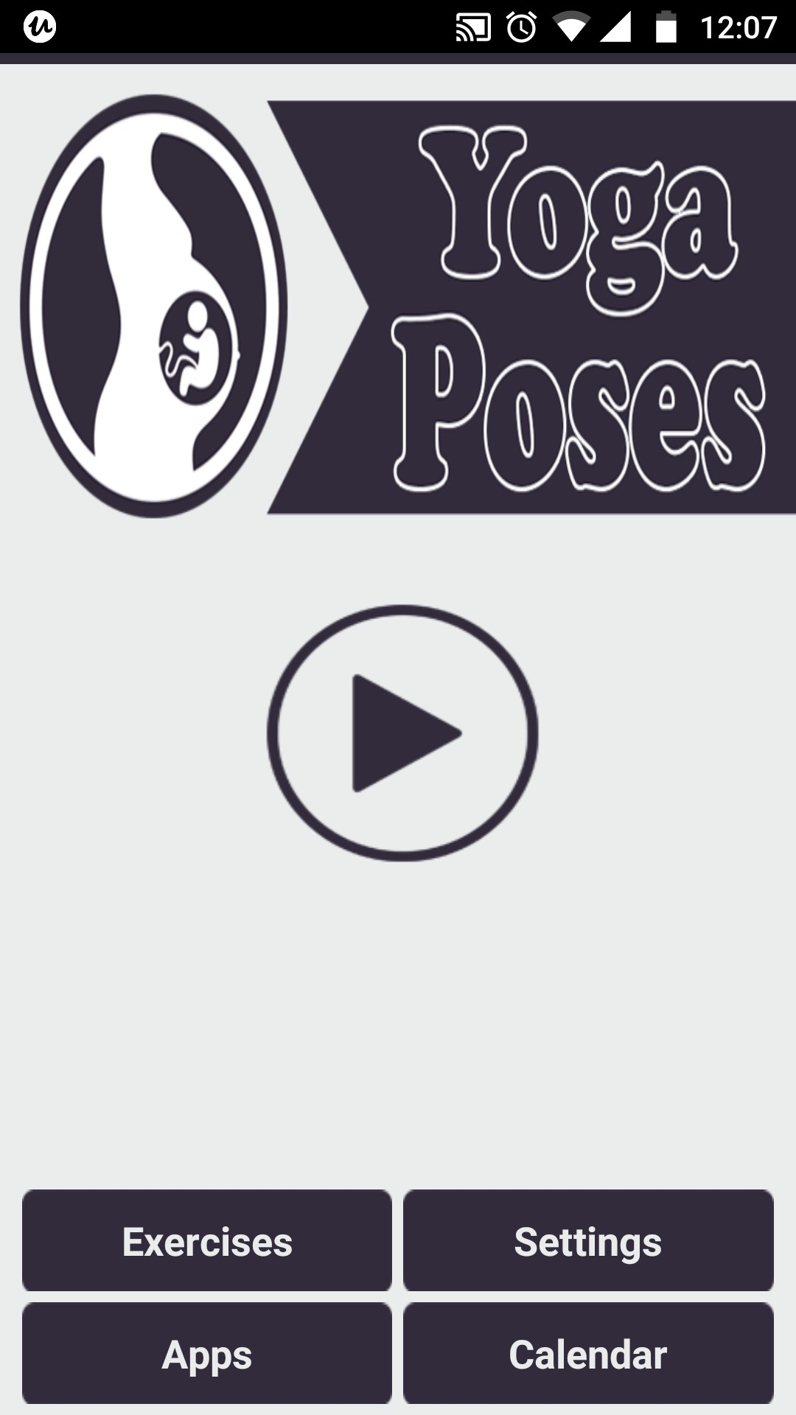
Pregnancy yoga Exercises
OVERVIEW:
We’ll be analysing a potential competitor “” Pregnancy yoga Exercises” app In this app user will find some poses and exercises yoga and other relaxation techniques to do during pregnancy as Yoga exercises good for mother and baby.
Prenatal Yoga Lessons and exercises, dedicated specially for pregnant women.
**Some Benefits of Pregnancy yoga**
Helps reduce backaches, constipation, bloating, and swelling
May help prevent, or treat, gestational diabetes
Increases your energy
Improves your mood
Improves your posture
Promotes muscle tone, strength, and endurance
Helps you sleep better

Slide 3
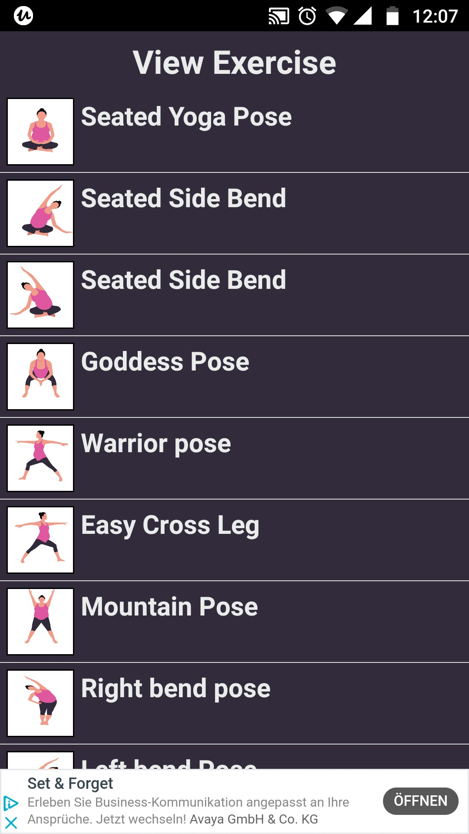
Pregnancy yoga Exercises
KEY OBJECTIVE:
In this app user will find some poses and exercises yoga to do during pregnancy
Bottom line
This app is free
No need to sign in/ sign up
Very basic structure and design
Easy to use with timer

Slide 4
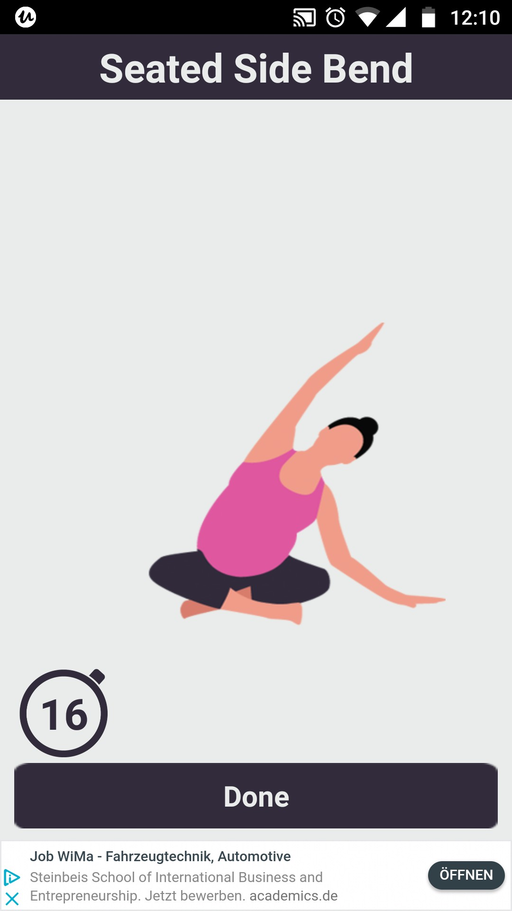
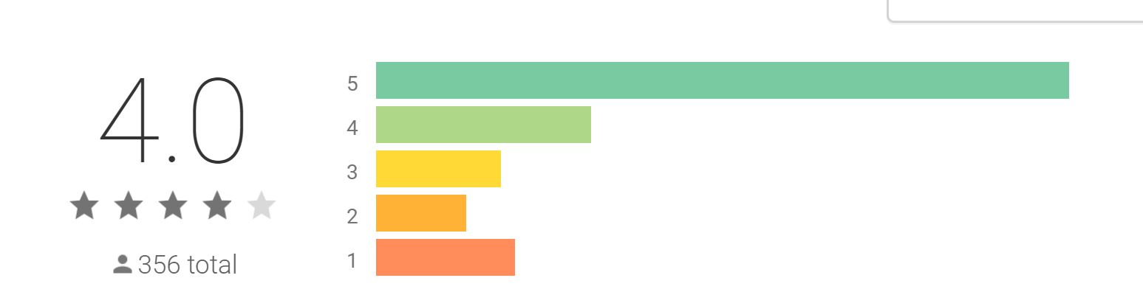
Pregnancy yoga Exercises
OVERALL STRATEGY:
The strategy of this app is to give users a way to get stated doing yoga without any distraction. Just choose the yoga pose from provided list and start doing it with the timer. Once done click on button and do next exercise
Bottom line
Categories are Exercises, Apps, Settings and calendar
Calendar help to keep the track of yoga
In setting user will able to set the reminder alarm for yoga
They have a great rating on the app store

Slide 5
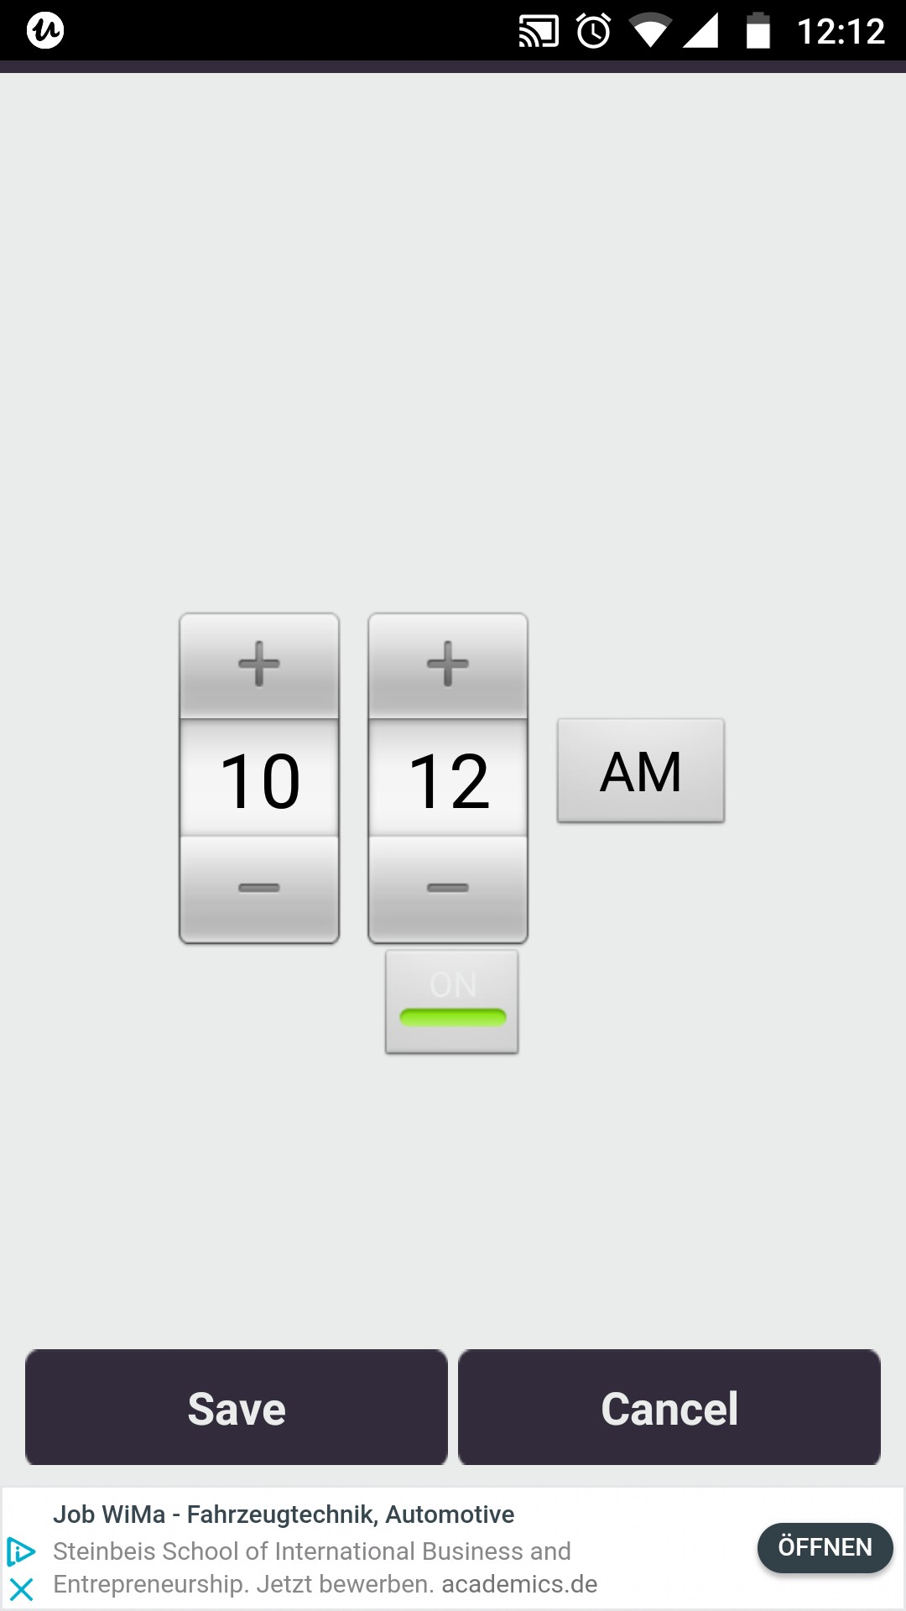
Pregnancy yoga Exercises
MARKETING PROFILE AND MARKETING ADVANTAGE:
I don’t find any presence of this app on social media. But in google play store they are able to attract the user and installed more than 100,000+ users and very much satisfied users.
Bottom line
They’ve positioned themselves highly in the top Google results
They’ve stuck to their original mission
Installed by 100,000+ worldwide

Slide 6
SWOT PROFILE: “Pregnancy yoga Exercises”
Strengths:
Opportunities
• Helped Over 100,000+ worldwide
• No need to register
• Free of charge
• Easy to use with simple design
• High 4.0 rating in google pay store
Build a delightful user experience with the app where users can explore pregnancy yoga experts and ask the questions free of charge.
Enabling users of the app to choose between communicating by voice, video or texting with yoga experts in terms of prenatal and postnatal.
Weaknesses:
Threats:
No registrations, impossible to maintain the users profile
Will be more interesting if it's colourful, video attached, and some explanation regarding the step involve
Missing of back button at some places
Prenatal Workout
Yoga for Pregnant Women

Slide 7
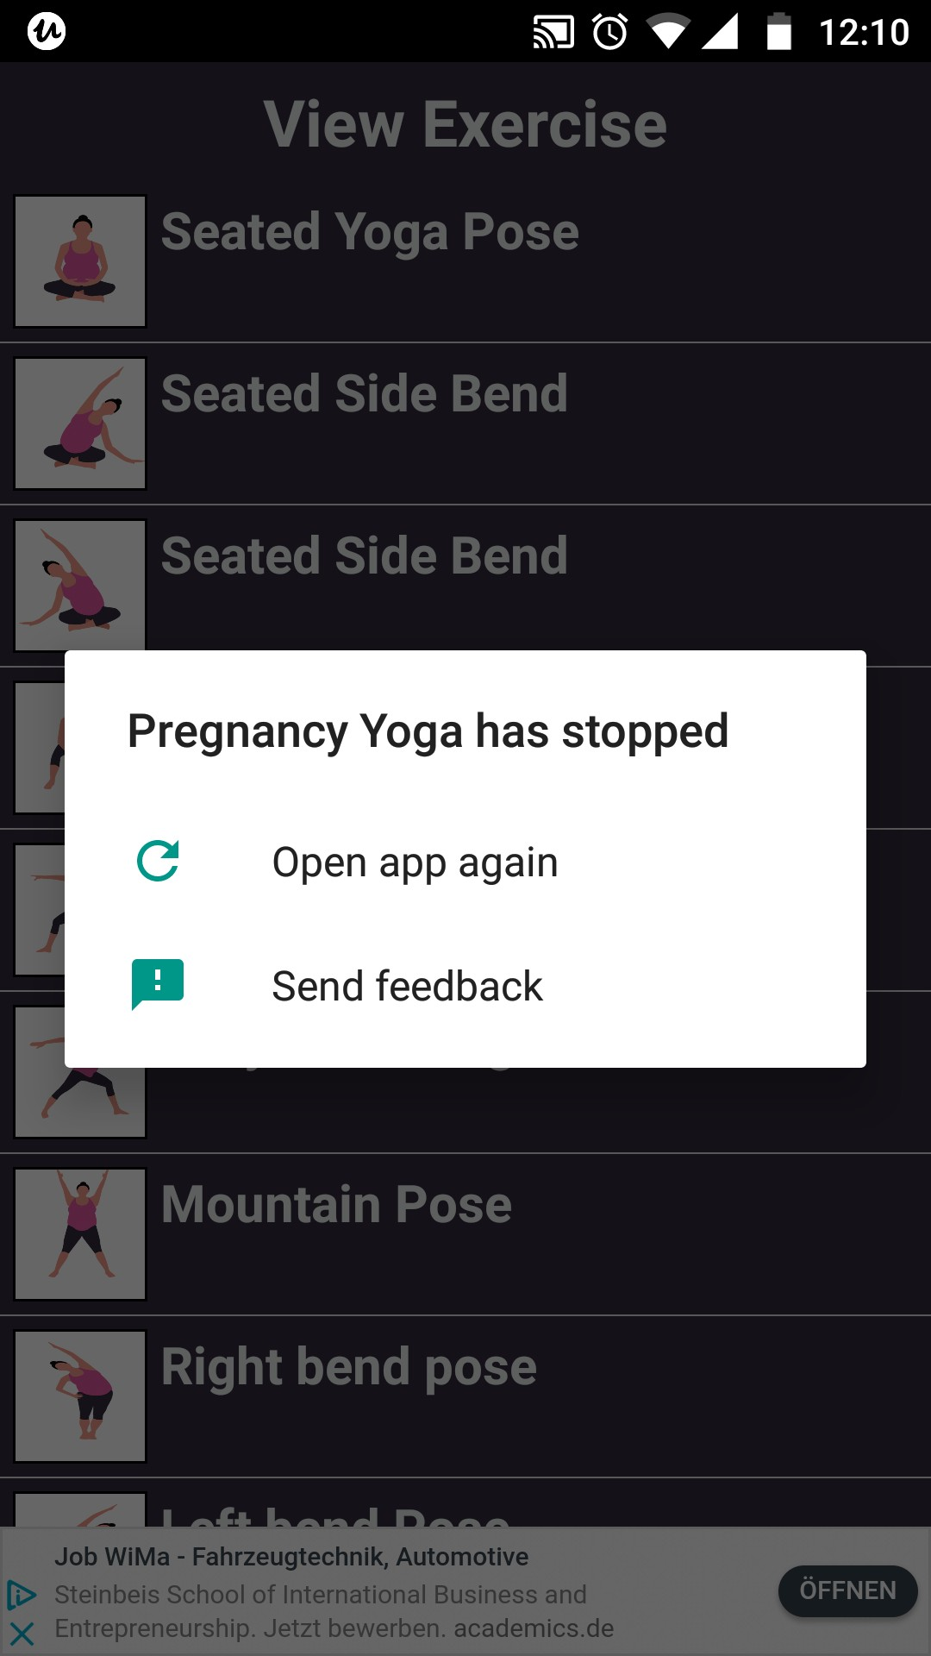
Pregnancy yoga Exercises
UX Analysis
Usability:
The app isn’t particularly difficult to use, but there are some aspects that feel unfinished. Such as missing of process.
Layout:
The layout is simple, But missing of search button and back button at some point make it uneasy. The app has a limited exercises.
Navigation Structure:
Navigation is so user friendly. But at some places user are stuck and don’t know how to go next/back.

Slide 8
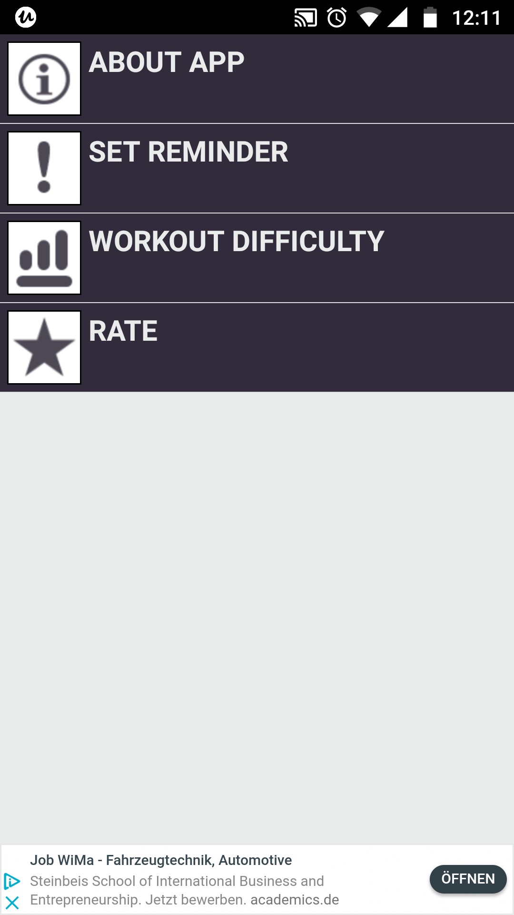
Pregnancy yoga Exercises
UX Analysis
Compatibility:
This app is compatible with web and Android 4.0 or later versions.
Differentiation:
This app does not meet all the requirement and specification as, I am looking for my project. But it follows the same concept of Pregnancy yoga guide. This app is base on self learning approach.
Calls to Action:
Users are free to use the app but with annoying advertisement at the bottom of the page and no solution how to remove it.

Slide 9

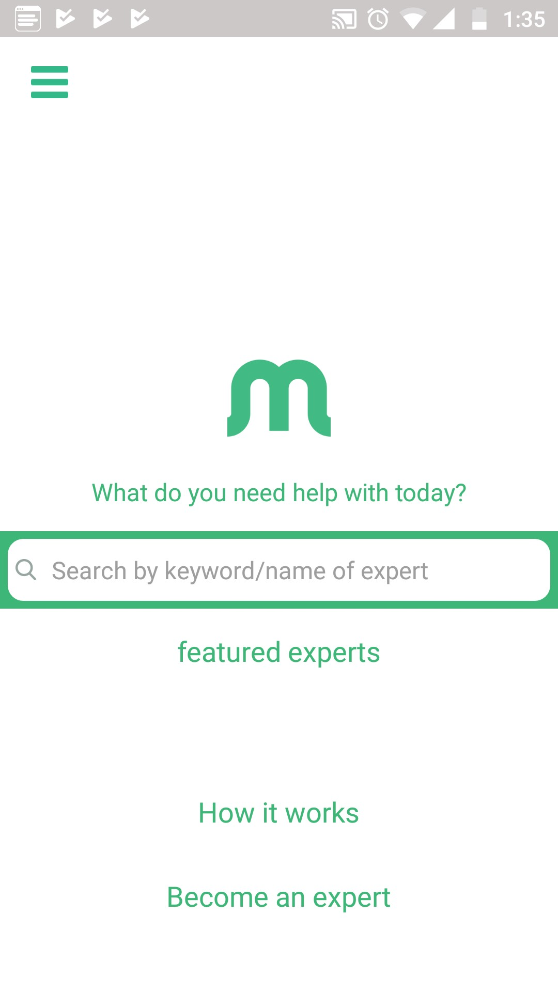
“Magnifi” app
OVERVIEW:
We’ll be analysing a potential competitor “Magnifi” app Magnifi is a global mobile knowledge sharing market network. (https://magnifi.io/)
The Magnifi market network is designed to solve many of the common hurdles and barriers faced by both knowledge providers and seekers. Magnifi’s patented audio and video consulting platform allows knowledge providers to bill and get paid-by-the minute via their mobile device while seamlessly integrating back-office tasks and functionality at the same time allowing knowledge seekers to get expert help in real-time and pay only for the time they need, anytime, anywhere.

Slide 10
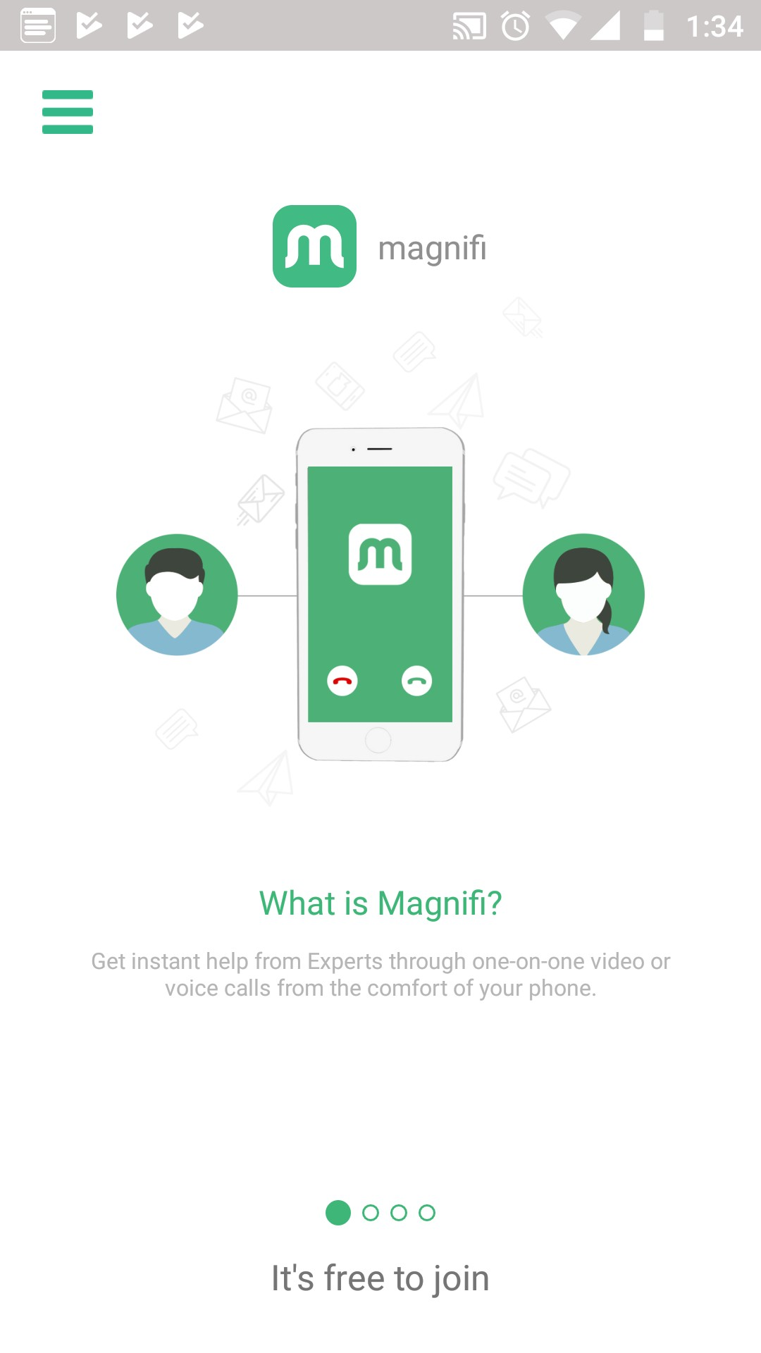
“Magnifi” app
KEY OBJECTIVE:
Magnifi is a global mobile on-demand knowledge sharing market network, connecting knowledge workers (experts) with knowledge seekers through paid, real-time audio/video consultation. Getting expert help on-demand is easy.
Bottom line
The Magnifi market network provides a seamless end-to-end solution that handles chat, video.
Billing while delivering audio and video experience.
It’s free to join

Slide 11
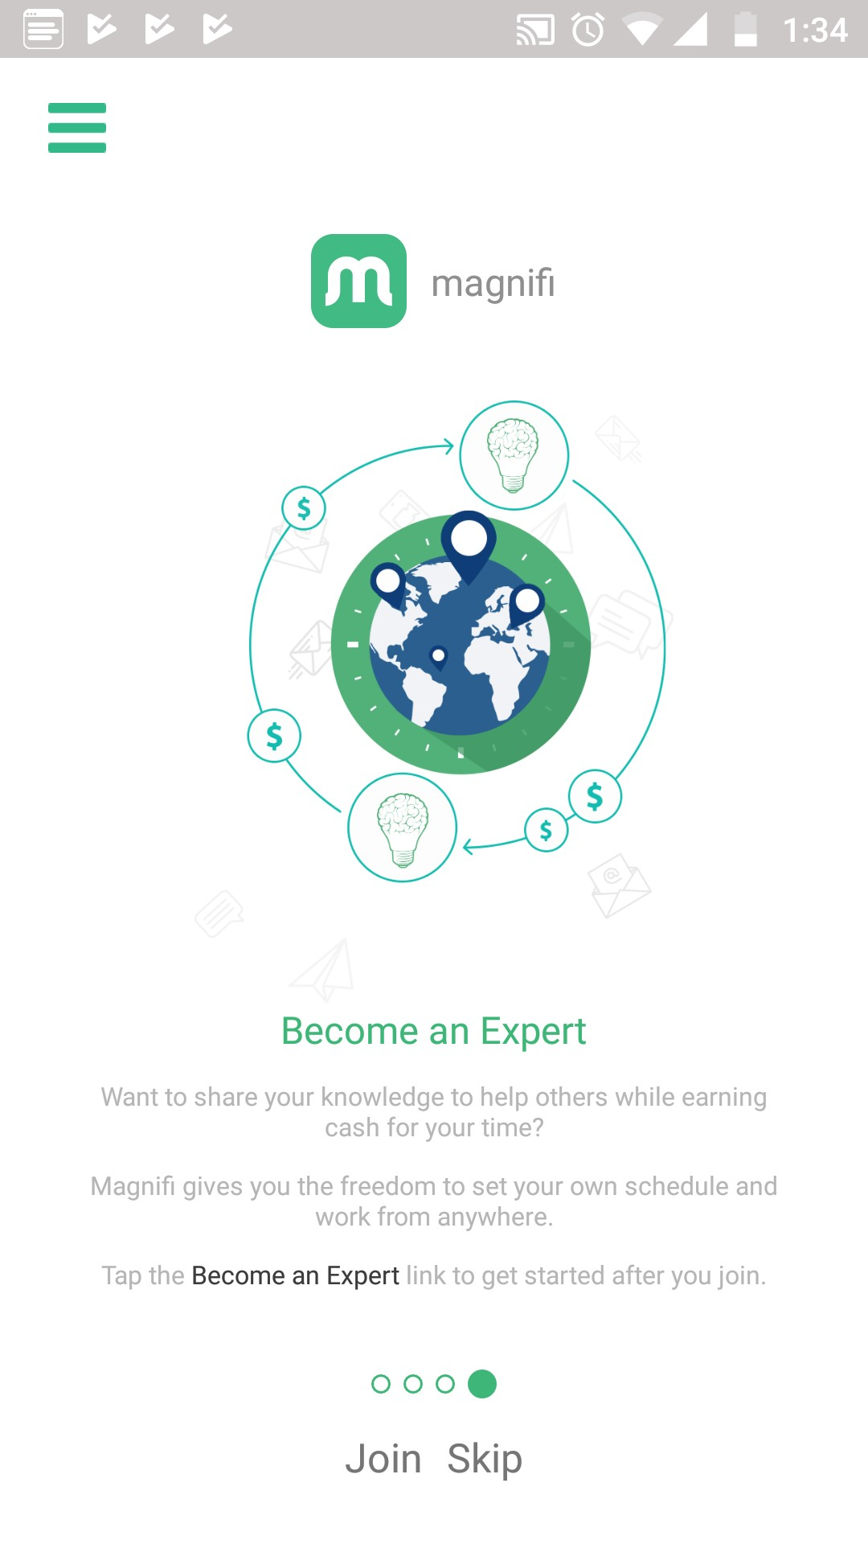
“Magnifi” app
OVERALL STRATEGY:
The strategy of Magnifi is to give users a way to get advice on-the-go and on-demand from the click of a button. The rating system creates a sense
of accountability to keep all sides honest and trustworthy.
Bottom line
Provide guide for “How You Can Get Started”
Focus on live chat with experts through video and audio
Knowledge providers and clients rate each other after a call

Slide 12
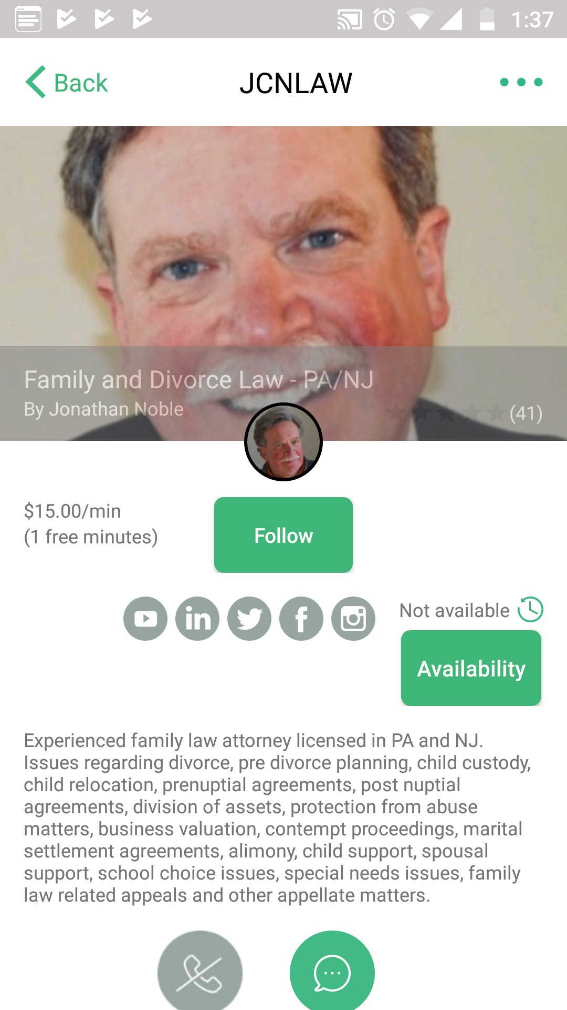
“Magnifi” app
MARKETING PROFILE AND MARKETING ADVANTAGE:
Magnifi is the leading global mobile market network for knowledge providers, they have a strong social media presence on Twitter and Instagram, facebook, Likndin and You tube.
They also encourage experts to invite their clients outside Magnifi to join them on the app to have a structured way to connect.
Bottom line
Paly when used, credit cards not needed for joining
New version will launches soon with some more features such as Expert profile preview, Email Verification,
Adding/deleting credit cards, Selecting default credit cards

Slide 13
SWOT PROFILE: “Magnifi”
Strengths:
Opportunities
Provide the user guide on boarding of the app
Simple intuitive design
Free to browse only pay when needed
Shows experts’ available times to chat
Review based to create trust among users and experts
Need to hire someone with real implementation experience
if your vision is to spread knowledge, allow access to answers for people who don't have an account
Think about monetizing the service and creating a revenue stream.
Weaknesses:
Threats:
Limited amount of experts in a given specialised area
Users can’t browse topics by category
Irrelevant expert list appears
Whatup
Reddit
Industry specific expert market places
JustAnswer

Slide 14
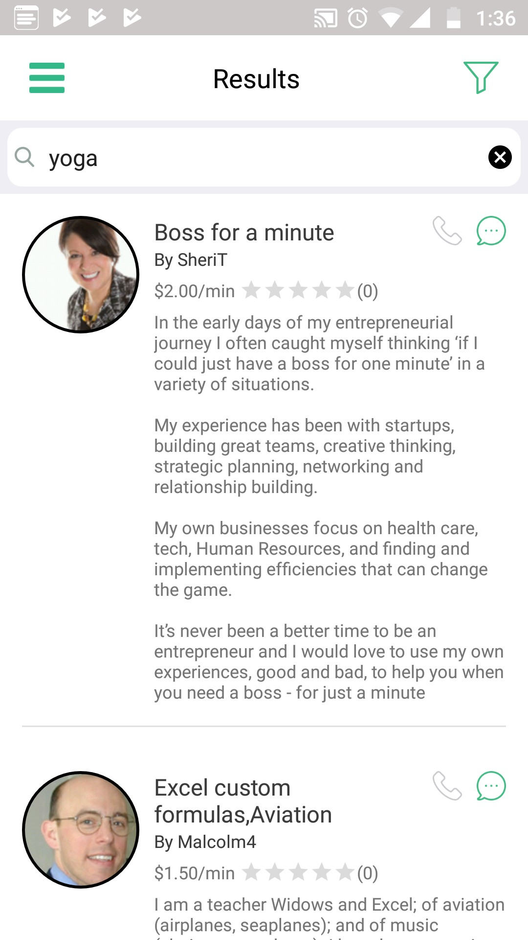
“Magnifi” app
UX Analysis
Usability:
App has all components which makes it easier to use. The apps main feature is to ask a question, but I’d like to be able to search and review experts profiles. The app is a limited extension of their website.
Layout:
The layout is simple, after login user would look through the expert list, apply search filter, such as find the expert by location, price…etc. It will come upon a list of experts
to click on and view a detailed profile page that provides all information.
Navigation Structure:
Navigation is so user friendly, user need to go through the categories of expert or search directly and reach out the list of expert, view, book call with them as per availability.

Slide 15
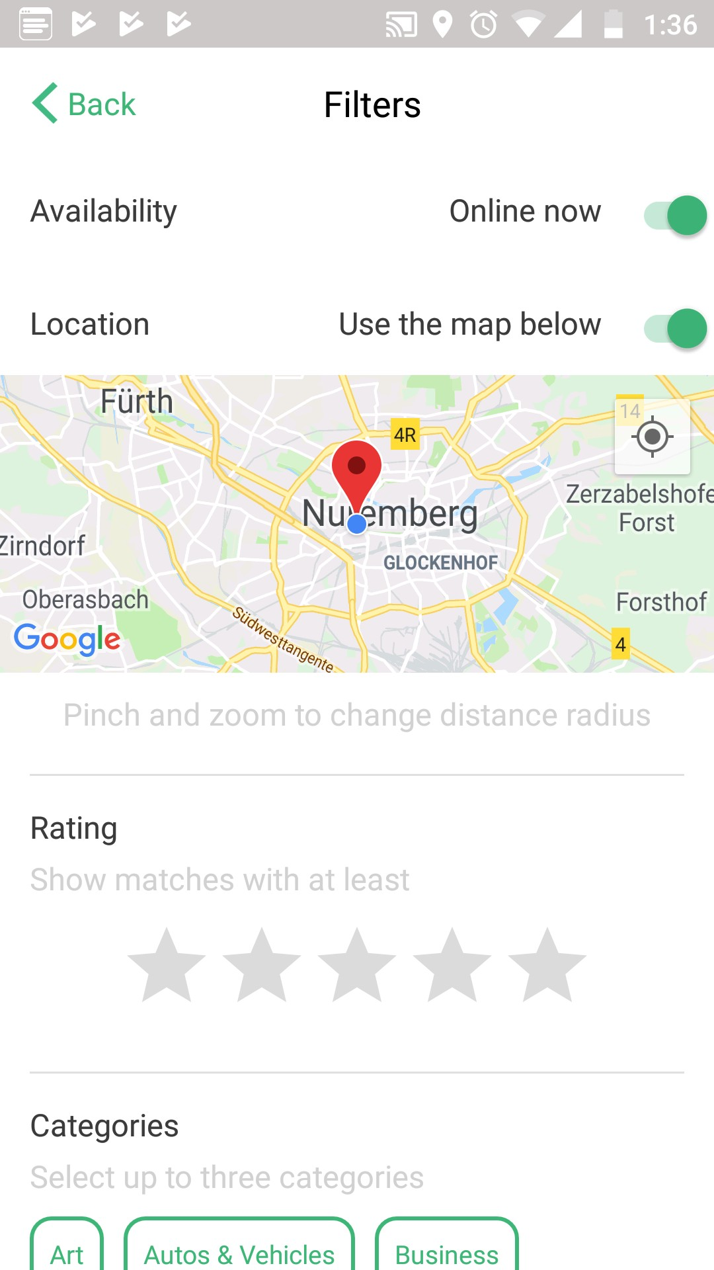
“Magnifi” app
UX Analysis
Compatibility:
This app is compatible with all of your devices. Currently app is in development, It may be unstable.
Differentiation:
Magnifi is a simple and easy to use app that provides audio and video consulting platform allows knowledge providers to bill and get paid-by-the minute via their mobile device. Search feature allow user to apply filter as per requiremt that make this app super cool, so that purpose of using this app became easy.
Calls to Action:
The Calls to Action are pretty straight forward, you pay when you have a call with an expert and their price is listed on their profile so you know how much you pay per minute.

Slide 16

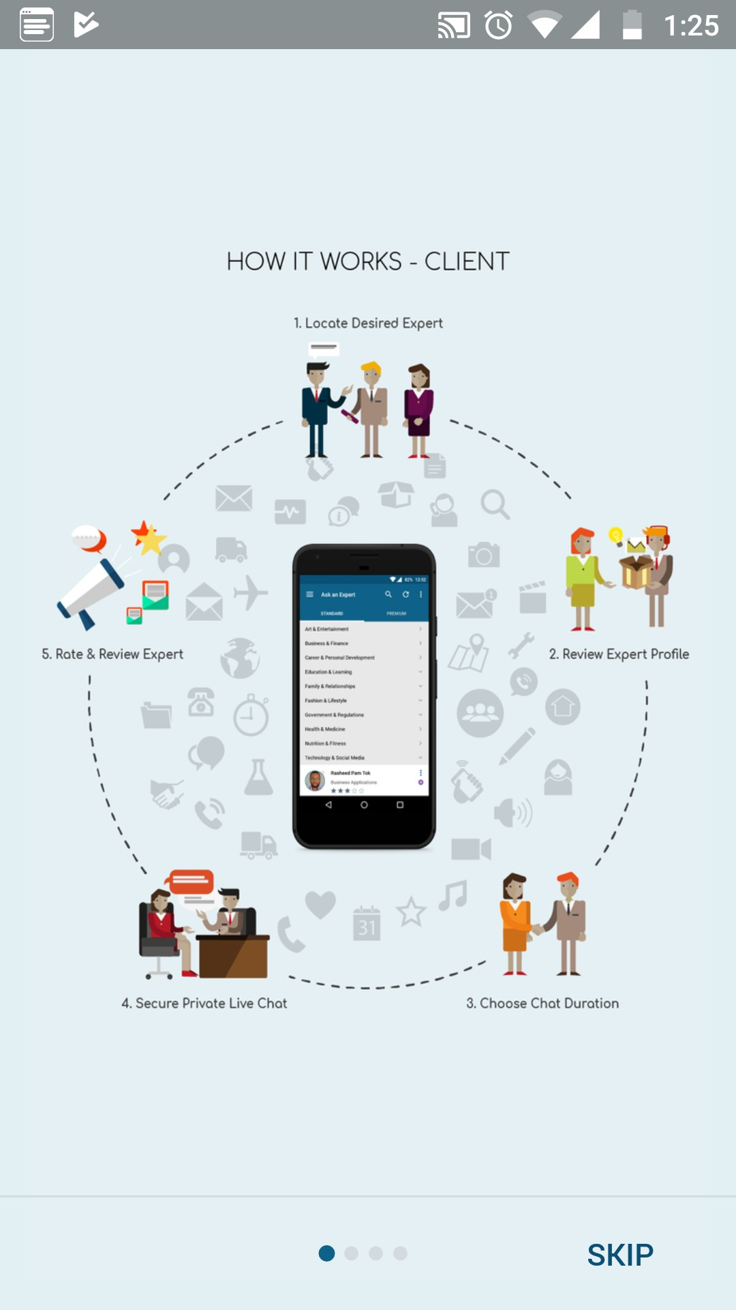
“Ask an Expert” app
OVERVIEW:
We’ll be analysing a potential competitor “Ask an Expert” (https://www.askanexpert.expert/) App is a solution that enables people to Connect with established “Expert” Individuals or Organisations from diverse fields, to get direct advise or insights on any topic to aid people in better decision making daily in real time.
The app incorporates successful technology models onto one platform i.e. combining On-Demand, Private Messaging, Expert Network and Micro Blogging features, to enable connection to expertise, advisory, insights, counselling, coaching, consultations, mentor ship and business customer services to be easily accessed.

Slide 17
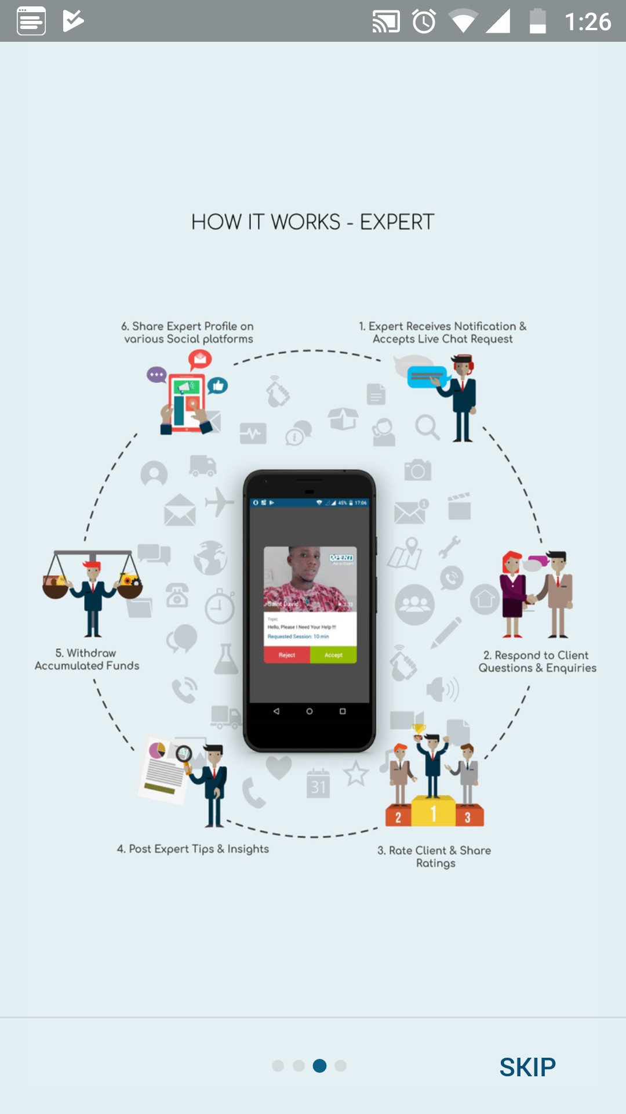
“Ask an Expert” app
KEY OBJECTIVE:
The app incorporates successful technology models onto one platform i.e. combining On-Demand, Private Messaging, Expert Network and Micro Blogging features, to enable connection to expertise, advisory, insights, counselling, coaching, consultations, mentor ship and business customer services to be easily accessed.
Bottom line
Provide guide for “How You Can Get Started”
Focus on live chat with experts
Provide the verities of option for plan subscription

Slide 18
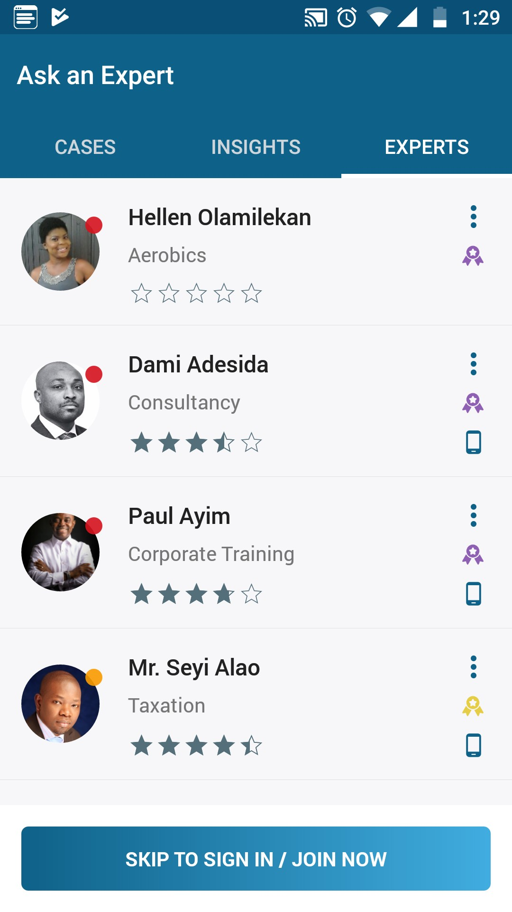
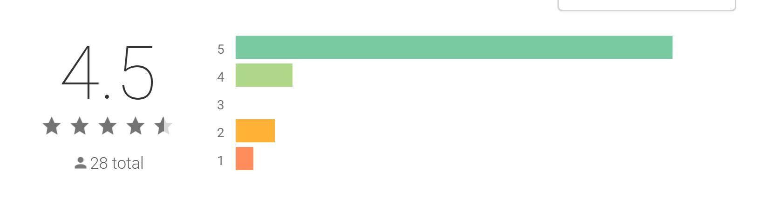
“Ask an Expert” app
OVERALL STRATEGY:
The strategy of “Ask an Expert” is to give users a way to get advice on-the-go and on-demand from the click of a button.
Experts can register and engage directly via this mobile app and gain visibility to millions of enquiring users to access a one-stop mobile marketplace directory of experts across any field or speciality.
Bottom line
Categories on cases, Insights, and experts
Their blog is free guide for users
They have a great rating on the app store

Slide 19
“Ask an Expert” app
MARKETING PROFILE AND MARKETING ADVANTAGE:
Ask an Expert has a strong social media presence on apps like Facebook, Twitter and YouTube for reviews and ads to promote their app.
They also encourage experts to invite their clients outside to join them on the app.
But also notice that since long time they haven’t promoted any new relase version on social media.
Bottom line
They’ve positioned themselves highly in the top Google results
They’ve stuck to their original mission
Installed by 1,000+worldwide

Slide 20
SWOT PROFILE: “Ask an Expert”
Strengths:
Opportunities
• Helped Over 1000+ worldwide
• Provide the user guide on boarding of the app
• Free to browse only pay when needed
• Strong leadership team and directors
• High 4.5 rating in google pay store
Build a delightful user experience with the app where users can explore experts by categories and empowering them to connect with experts of their choosing.
Enabling users of the app to choose between communicating by voice, video or texting with Experts.
• Add a search feature to the app
Weaknesses:
Threats:
Login with mobile number instate of Email or social media, this may feel unsafe at the begging of the app
Very basic interface, has scope for more intuitive interface design
Magnifi
Industry specific expert market places
JustAnswer

Slide 21
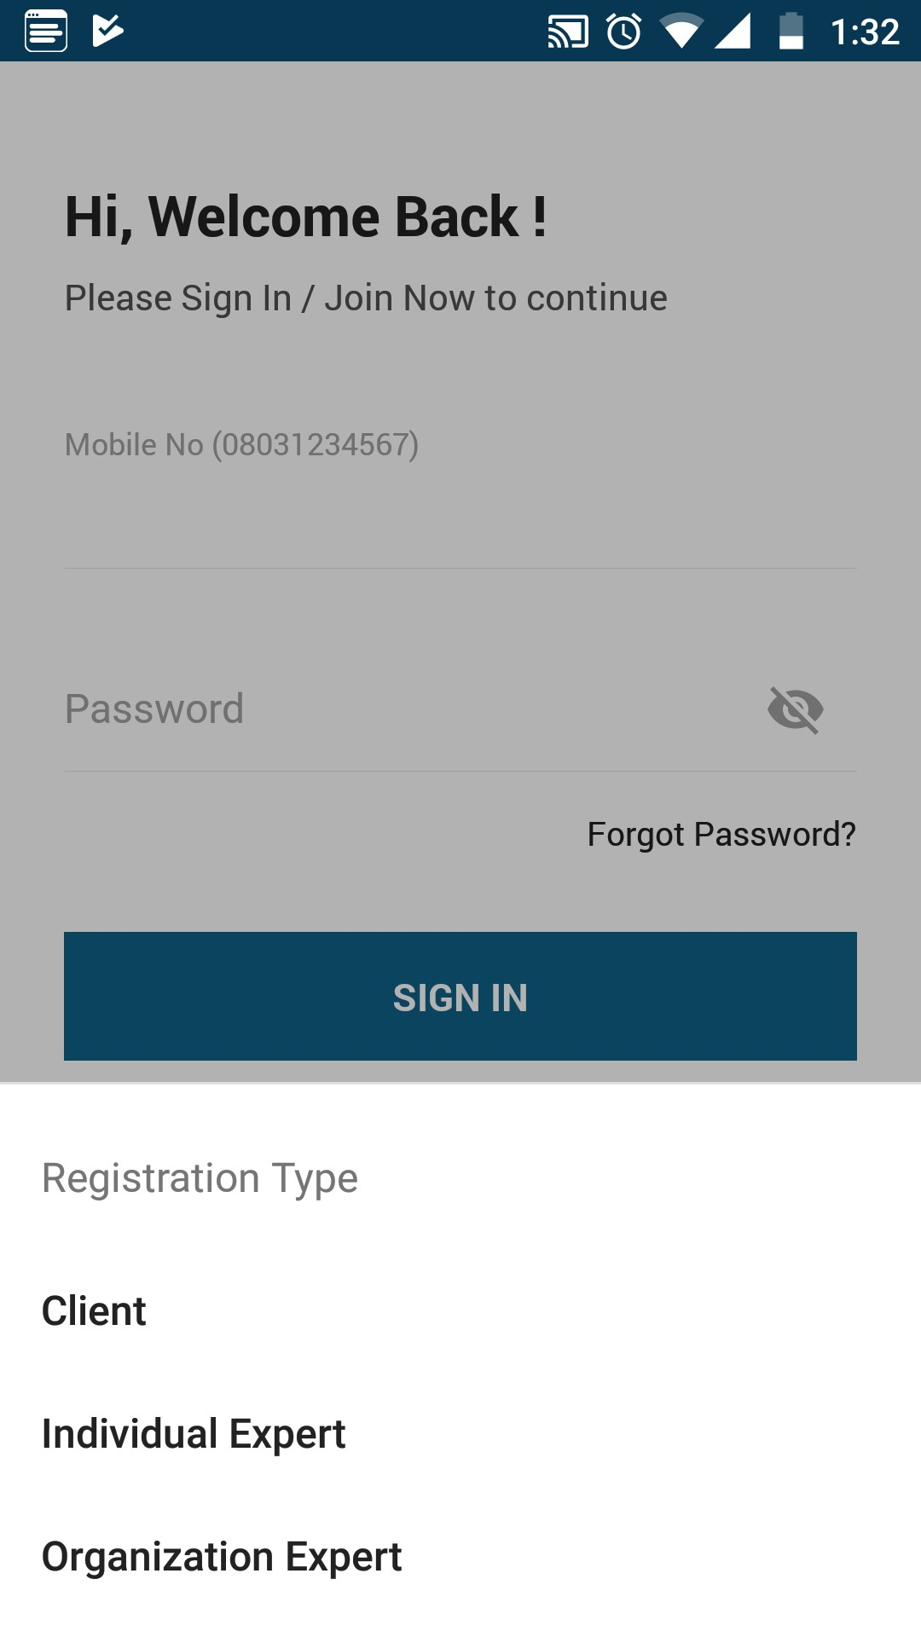
“Ask an Expert” app
UX Analysis
Usability:
The app isn’t particularly difficult to use, but there are some aspects that feel unfinished. Awkward for instance, such as login with mobile number. Missing of search button on Home screen.
Layout:
The layout is simple, without login user would look through the expert list. But missing of search button make it uneasy to find the particular expert. The app is a limited extension of their website.
Navigation Structure:
Navigation is not so user friendly, user need to go through the categories of expert.

Slide 22
“Ask an Expert” app
UX Analysis
Compatibility:
This app is pretty much compatible with web and Android 4.1 or later versions.
Differentiation:
This app does not meet all the requirement and specification as, I am looking for my project. But it follows the same concept of On-Demand, Private Messaging, Expert Network and Micro Blogging features, to enable connection to expertise. It lack in searching feature and in over all user experience.
Calls to Action:
Users are free to browse the app but with annoying notifications pushing them to sign up. At any time, they can access the sign up option from the home screen. The sign-up/login process present requires mobile number.

